Slide 1

Security Awareness!
Assume Breach!
Says Who? Maybe the Logs?

Slide 2
Disclaimer
WARNING…
Following presentation contains my thoughts, ideas and opinions. They do not represent those of my current or past employers.
Any events, characters and company depicted in the course of this presentation are purely fictitious. Any similarity to actual events, characters and company is merely coincidental. <-Like South Park!
Do not use these tactics/techniques presented for evil.
Notes:
Disclaimer.

Slide 3

WHO Am I?
Red Team Hacker / Defender
Jesse Moore
Pet Parent to a Chihuahua
Cybersecurity Advisor for Office of the CISO | UW Bothell
Education (lots of self-study):
Bachelor’s of Science IT Security
GIAC-PEN (Penetration Tester)
GIAC-CFA (Certified Forensic Analyst)
https://www.linkedin.com/in/jessefmoore/
Jessefmoore+DFIR@gmail.com
Notes:
Who Am I?
A red team is a group that challenges an organization to improve its effectiveness by assuming an adversarial role or point of view.
Next Slide is “We Can Defend”

Slide 4

Together We Can Log (Catch Bad Stuff!)
Security depends on US! Yep, Security is a Shared responsibility…
Reference: http://www.washington.edu/boundless/
Notes:
Security needs to just be another component in system engineering…
The test machine was a Windows 10 Enterprise.
This is an approach on a shoestring budget with no shipping the logs off the machine.
I encourage using GPO to control settings.
1. This is originally created for a MeetUp presentation intended to provide System Admins and System Engineers awareness of some things that can be done to detect.
2. This is also heavily focus on Windows operating systems and familiarity with some system admin tools and cmd prompt are assumed.
3. This is not an exhaustive list of all (web server, Proxy, Load Balancers, NAT) the logs, this is just the start on a shoeString budget.
4. I will not go over Log retention or compliance like PCI (1year), HIPPA (6 years), Sarbanes Oxley Financial systems/audit records (7 years)
Next Slide: What is the Agenda?

Slide 5
What is the Agenda?
…
Assume Breach
Demo (After attacker gets in); tactics and techniques
Empire
Search for data
Download sensitive data
Persistence
Demo Enable Logs to detect
An approach to Enable Logging via scripts
Audit Policy, Registry Logging and Folder Audits
This will Adhere to best practices/standards
Notes:
Assume Breach
Demo of attacker
Demo of enable logs
Adhere to best practices/standards
Next Slide: Let's talk about Assume Breach

Slide 6
Okay, let's talk Assume Breach!
…
Just assume the attacker is already inside the Network and inside your Machine.
1. Have a iterative process to capture attacker artifacts once they are on the network and machine.
2. Have a response plan
3. Have a recovery plan
4. Have a process to prevent/detect what artifacts the attacker leaves on your network
https://ciso.uw.edu/about-us/assumption-of-breach
Notes:
Detection, Response, Recovery, and Prevention of attacks
Basically I like to think of it as an attacker will get in and if he does do we have things to detect?
Next Slide: Some (Verizon DBIR) would say that most compromises start with phishing.
https://ciso.uw.edu/about-us/assumption-of-breach/
https://www.eventtracker.com/blog/2016/january/the-assume-breach-paradigm/

Slide 7
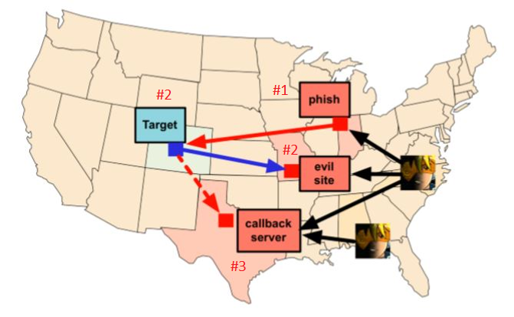
Assume Breach Phishing Success
Send Phish via C2
Target clicks & or goes to EvilSite to obtain and execute malware
Then Target calls C2 server waiting for Adversary commands
https://www.cobaltstrike.com/downloads/csmanual311.pdf
Notes:
1. This shows a red team infrastructure and how they setup and implement C2.
2.Now that we are on a target system (could be your windows workstation)
Next Slide: GUI of adversary workstation and their Command and Control
Phish → Creds -> System Access->Empire C2C
Phish → Creds -> System Access-> Meterpreter

Slide 8
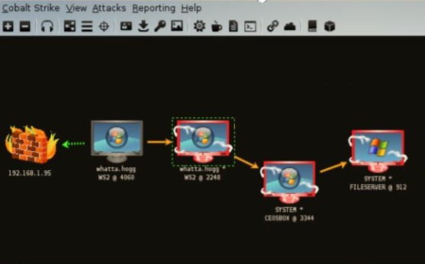
Phish Click! – Assume Breach Activated.
https://www.cobaltstrike.com/downloads/csmanual311.pdf pg.12
Notes:
1. After CLICK Here we have a foot hold (compromised a computer)
2. This scenario will be a targeted attack so no lateral movement needed.

Slide 9
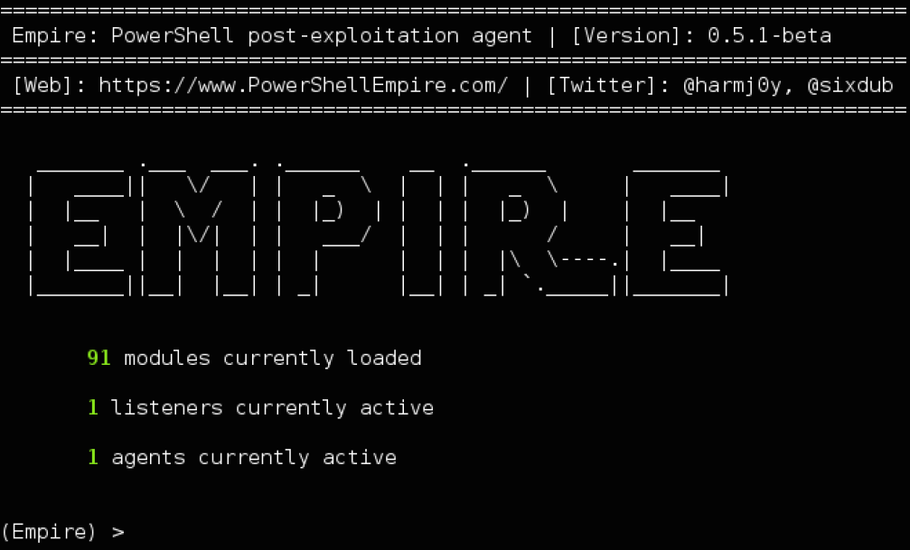
Assume Breach with | PowerShell Empire
Reference:
https://www.powershellempire.com/
Notes:
What is Empire?
Is a Post-Exploitation software and can emulate the post-exploitation action of advanced threat actors.
https://github.com/EmpireProject/empire/wiki
NEXT SLIDE: Empire Demo components

Slide 10
EmpireBreach DEMO
1. Search for sensitive data such as FERPA, finances, passwords, etc
2. Download the sensitive data
3. Add Persistence to come back when we want to grab more stuff.
Notes:
Next Slide: Demo

Slide 11
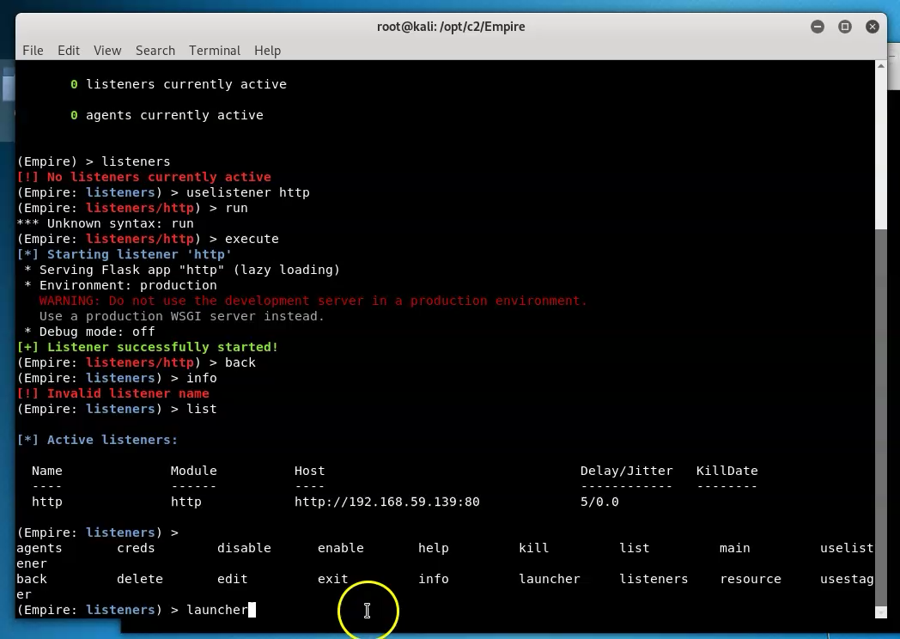
Assume Breach Empire Attack!
…
DEMO
C2C inside network (Empire)
https://screencast-o-matic.com/u/vqZ/Assume
https://screencast-o-matic.com/u/vqZ/Assume2
https://screencast-o-matic.com/u/vqZ/Webexec
Notes:
Next Slide: Lets talk BlueTeam and detection.
Specifically an approach to threat hunting, err I mean logging..
6:56 minutes into WebExec to leverage vuln of WebExec to escalate to SYSTEM which has full control
https://screencast-o-matic.com/u/vqZ/Webexec

Slide 12
An approach to threat hunting; Err logging, Err I mean collecting data
Can’t do much if you don’t have Data… (Enable logging!)
Notes:
NEXT Slide: How do we catch activity?
Look for advanced persistent threats that routinely bypass conventional perimeter controls, i.e. Firewall, IPS/IDS, URL filtering, etc.
These threats could be Malware, BotNet intrusion, Phishing campaigns, C2 activity, anonymous behavior (ToR, OpenVPN, etc.), unauthorized P2P communication, etc. This is done by interrogating the endpoint.

Slide 13
How do we catch (Log/data) that Activity?
Use Logging Cheat Sheets
Simulate Adversary and collect data and develop detection.
Notes:
Get help from others in the industry such as Malware Archeology's resources.
Next Slide: Where do I find Logging CheatSheets

Slide 14
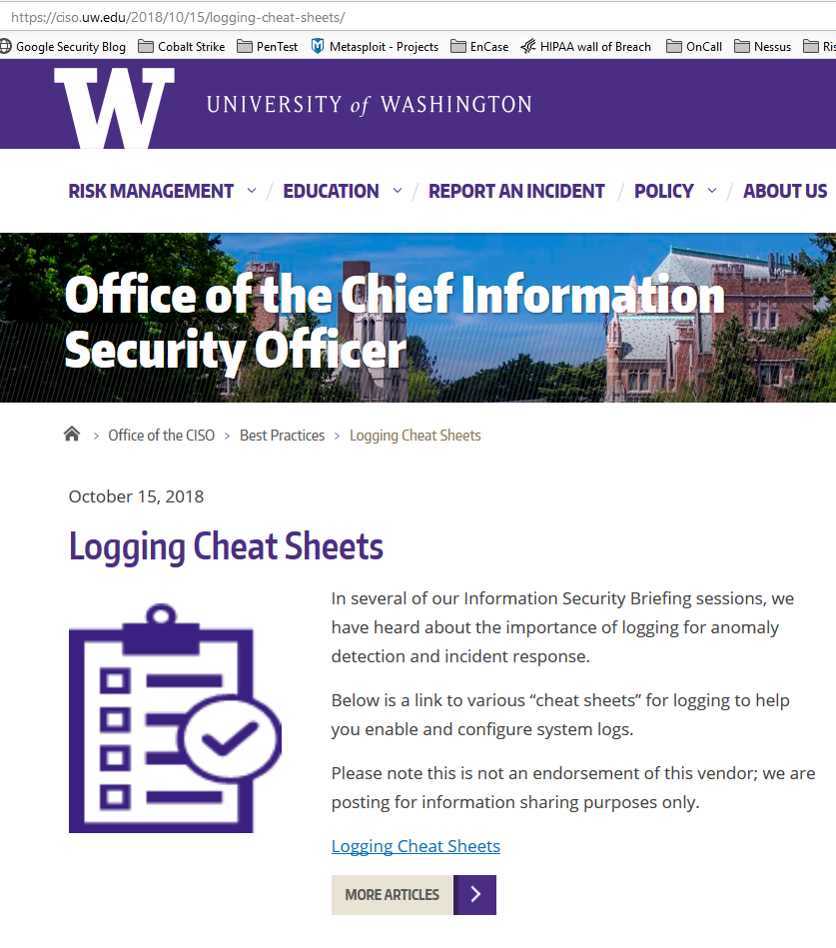
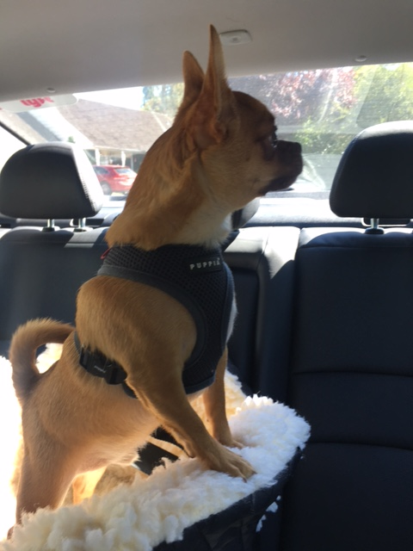
Office of CISO
https://ciso.uw.edu/2018/10/15/logging-cheat-sheets/
Notes:
Next is Malware Archaeology webiste that has scripts to enable logging

Slide 15
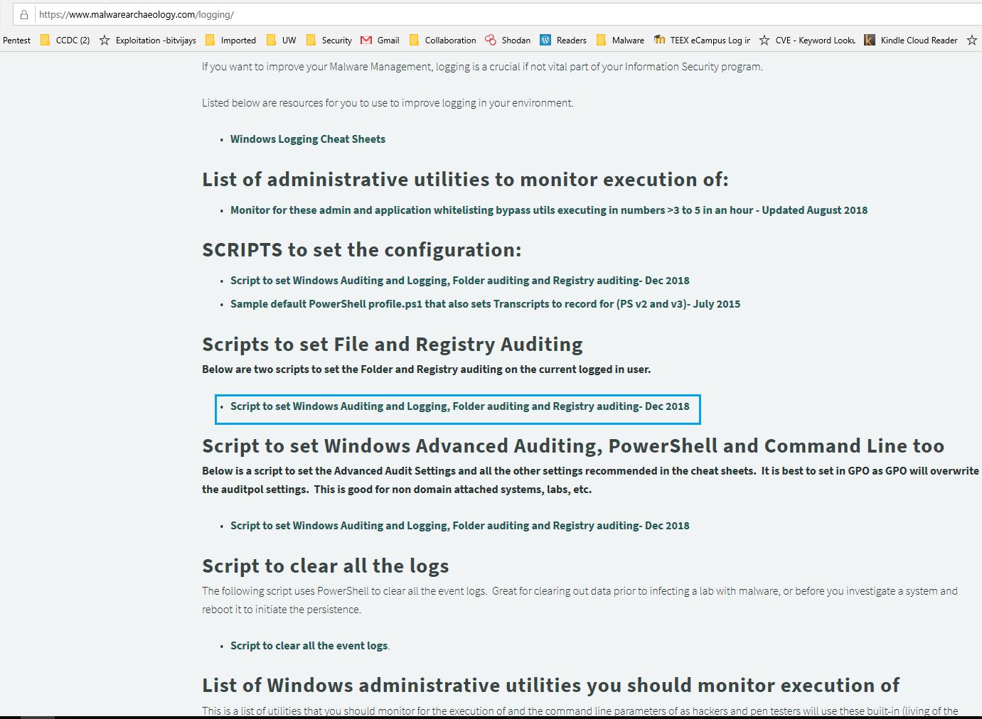
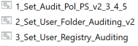
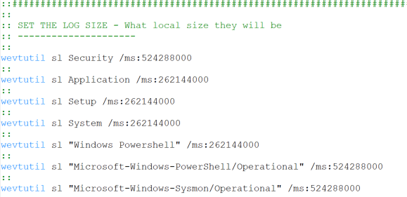
…
Notes:
Here is what the website looks like and sneak peek into what the scripts have inside…
Use these to create your own scripts, great starting point.
https://www.malwarearchaeology.com/logging
NEXT SLIDE: What will the scripts accomplish? Next is Log-MD to check (Compare 2 Benchmarks)

Slide 16
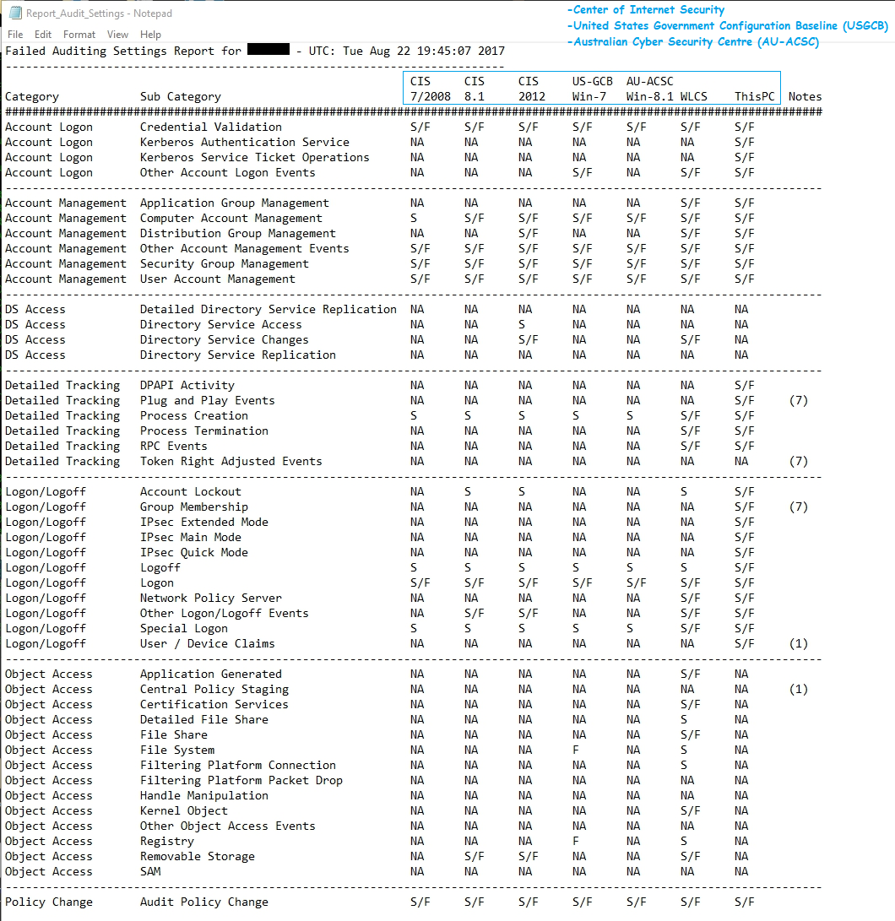

Logging (Detection) Standards
…
Notes:
Adhere to standards, and specifically go beyond with WLCS = Windows Logging Cheat Sheets.
The purpose of the United States Government Configuration Baseline (USGCB) initiative is to create security configuration baselines for Information Technology products widely deployed across the federal agencies. The USGCB baseline evolved from the Federal Desktop Core Configuration mandate. The USGCB is a Federal Government-wide initiative that provides guidance to agencies on what should be done to improve and maintain an effective configuration settings focusing primarily on security.
NEXT SLIDE: So what does Windows 10 default Audit Policy look like?

Slide 17
Win10 Pro by default
Audit Policy
No Registry logging
No user Folder Auditing
Lots of stuff missing…
Notes:
Next Slide: So We should Enable logging

Slide 18
Enable Logs
Use Malware Archeology Scripts to enable logs
Benefits
Detect activity (comply with best practices)
Larger EVTX files to store EventIDs
CMD line auditing
PowerShell logging
Registry Auditing (where evil hides)
Run Scripts
Scripts:
Audit Policy
User Folders
Registry
Reference: https://learn.cisecurity.org/cis-cat-landing-page
Notes:
Benefits to using Malware Archeology scripts are….
NEXT SLIDE: End …. DEMO Enabling logging via scripts

Slide 19
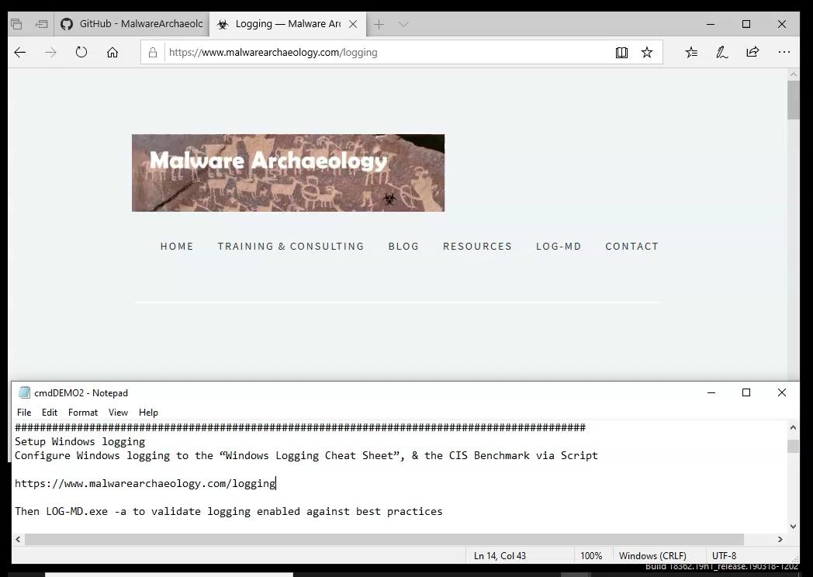
Notes:
https://screencast-o-matic.com/u/vqZ/EnableLogs

Slide 20
In closing …
¯\_(ツ)_/¯
… …
Assume Breach! & prepare for the attack!
Enable Logs/data to detect more things!
Script to automate enable logging:
https://ciso.uw.edu/2018/10/15/logging-cheat-sheets/
https://www.imfsecurity.com/compare <-Log-MD
Or just use Sysmon
https://docs.microsoft.com/en-us/sysinternals/downloads/sysmon
Notes:
1. Use GPO to Enable logs and comply and exceed CIS Benchmarks for logging.
2. Enable Logs with cheat sheets from Malware Archaeology
3. Monitor your logs for badness
4. This is only the beginning…
ADVANCE:
1. Simulate Adversary Tactics to obtain Detection mechanisms (behaviors) to create more monitors/detections.
NEXT SLIDE: Thank you!
RegMon: http://leelusoft.altervista.org/registry-live-watch.html
https://sourceforge.net/projects/regshot/
Cybersecurity Framework (CSF) Core: Identify, Protect, Detect, Respond, Recover
For an example of Detection Response team mappings:
Protect: CIS 3, Secure Configuration of End-User Devices
Detect: CIS 4, Constant Vulnerability Assessment & Remediation
Respond: CIS 6, Maintenance, Monitoring, and Analysis of Audit Logs

Slide 21

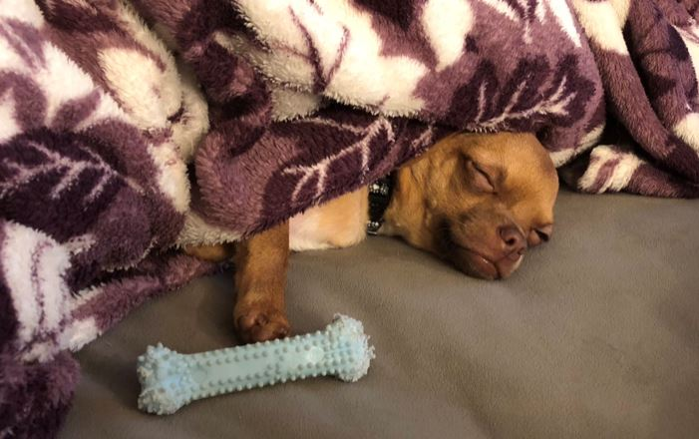
Thank you!
Contact info: moorej1@uw.edu | Twitter: @jessefmoore
Download Resources Here: http://bit.ly/InfoSecLogs
Notes:
Any questions?
As a group I have time for a hand full of questions, however I want to leave time for individual questions too for others that have other more specific to their issues they would like to talk 1:1 about.
Resources:
Future considerations is simulate adversary and create detections:
https://posts.specterops.io/enter-mordor-pre-recorded-security-events-from-simulated-adversarial-techniques-fdf5555c9eb1
https://github.com/sbousseaden/EVTX-ATTACK-SAMPLES/tree/master/Privilege%20Escalation
More advance but free option to ship logs off and analyze:
https://github.com/ukncsc/lme
https://github.com/Cyb3rWard0g/HELK
https://www.elastic.co/blog/introducing-elastic-siem
https://digital-forensics.sans.org/media/SANS_Poster_2018_Hunt_Evil_FINAL.pdf
Security.evt (Change log size to 4GB)
5140 - Share access (Network share access)
4672 – Administrator logon (Privileged acct usage)
4776 - Local Admin (Local account Auth)
4769 - Kerberoasting
4624 type 3 network
4624 type 10 RDP
PowerShell.evt log (Turn on PowerShell Script Block logging)
EventID 500 - PowerShell command line
EventID 400 - for PowerShell Obfuscation
EventID 4103, 4104 – Script Block Logging (suspicious scripts by default via PSv5)
Event ID 4104 - Execute a remote command using PowerShell and obfuscation
System logs – Monitor for Service Changes
7045: A service was installed
7040: Installed service was changed

Slide 22
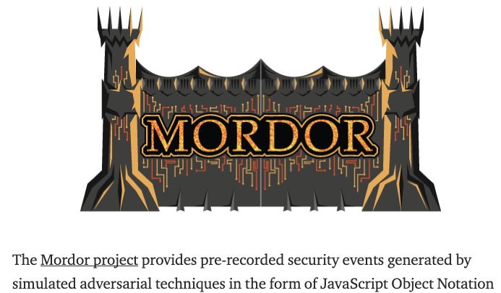
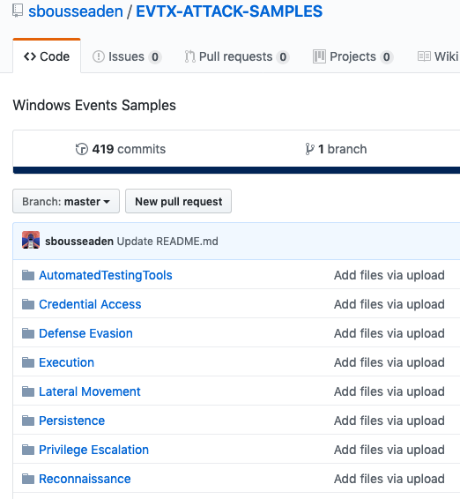
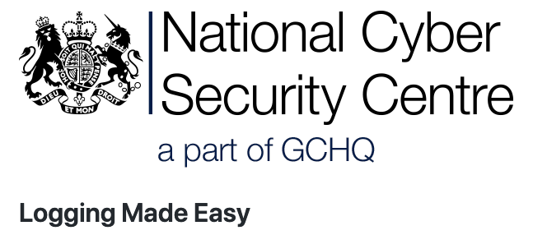
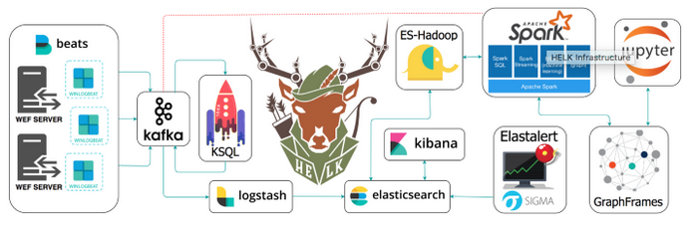
Notes:
If no audit settings are configured, or if audit settings are too lax on the computers in your organization, security incidents might not be detected or not enough evidence will be available for network forensic analysis after security incidents occur.
https://github.com/Cyb3rWard0g/HELK
https://posts.specterops.io/enter-mordor-pre-recorded-security-events-from-simulated-adversarial-techniques-fdf5555c9eb1
https://github.com/sbousseaden/EVTX-ATTACK-SAMPLES
https://www.elastic.co/blog/introducing-elastic-siem
https://github.com/ukncsc/lme
https://www.skadivm.com/
https://www.ultimatewindowssecurity.com/wiki/page.aspx?spid=SecuritySettings
https://docs.microsoft.com/en-us/windows/security/threat-protection/auditing/audit-directory-service-changes
https://blogs.technet.microsoft.com/jepayne/2017/12/08/weffles/
https://github.com/MalwareArchaeology/ARTHIR
https://github.com/redcanaryco/atomic-red-team
https://splunkbase.splunk.com/app/4305/
https://miriamxyra.com/2018/08/28/eventlist-the-baseline-event-analyzer/
Enable Audit ALL NTLM outgoing traffic
Monitor File share access/attempts to sensitive files
Jesse Moore presentation page 39 has more logs sources to consider:
https://www.slideshare.net/jessefmoore/adversary-tactics-config-mgmtamplogsohmy

